Slide 1
DIGITAL PORTFOLIO

Slide 2
DIGITAL PORTFOLIO
NAME : BALASAKTHI N
REGISTER NO : 2422k2423
NM ID : asbru072422k2423
DEPARTMENT : II – B.Sc ( Computer science )
COLLEGE : Lrg women’s arts and science college

Slide 3
PROJECT TITLE
Interactive digital portfolio

Slide 4
AGENDA
PROBLEM STATEMENT
PROJECT OVERVIEW
END USERS
TOOLS AND TECHNOLOGIES
PORTFOLIO DESIGN AND LAYOUT
FEATURE AND FUNCTIONALITY
RESULT AND SCREENSHOTS
CONCLUSION
GITHUB LINK

Slide 5
PROBLEM STATEMENT
Many students struggle to showcase their skills and projects effectively.
Traditional resumes lack visual appeal and interactivity
Need for a digital portfolio that highlights project, skills, and achievements clearly

Slide 6
PROJECT OVERVIEW
Developed a personal portfolio website for showcasing academic and technical skills.
Includes sections for About, Skills, Projects, and Contact.
Responsive design for both desktop and mobile users.

Slide 7
END USERS
Students & job seekers to present their work.
Recruiters to evaluate candidate skills quickly.
Client/Companies looking for project sample.

Slide 8
TOOLS AND TECHNOLOGIES
HTML, CSS, JavaScript – Structure, design, interactivity
Bootstrap/CSS Flexbox/Grid – Responsiveness
GitHub – Version control & hosting

Slide 9
PORTFOLIO DESIGN & LAYOUT
Hero banner with intro + resume button
Profile section with photo & detail
Skills with progress bars
Projects displayed in card layout
Certificates gallery
Contact form + footer

Slide 10
FEATURES & FUNCTIONALITY
Responsive website (mobile + desktop)
Project showcase with descriptions
Interactive skill progress bars
Certificate gallery with hover effects
Contact form with email & phone info

Slide 11
RESULT & SCREENSHOTS
Personal portfolio website build
Clear display of Skills, achievements, and projects
Screenshots : Below the screenshots are my portfolio website

Slide 12
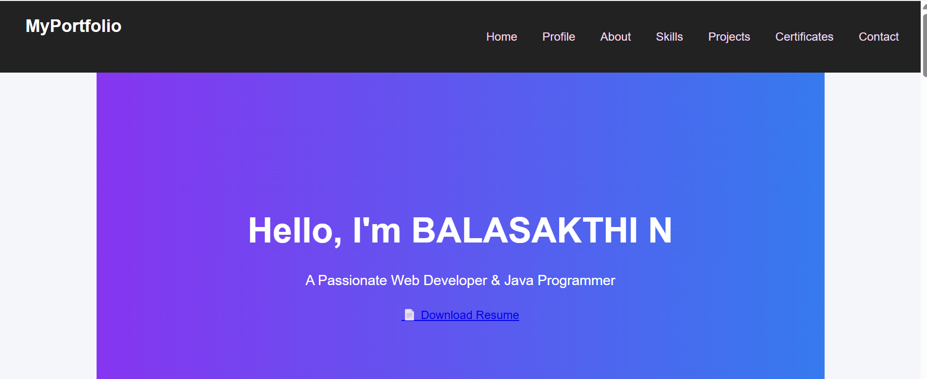

Slide 13
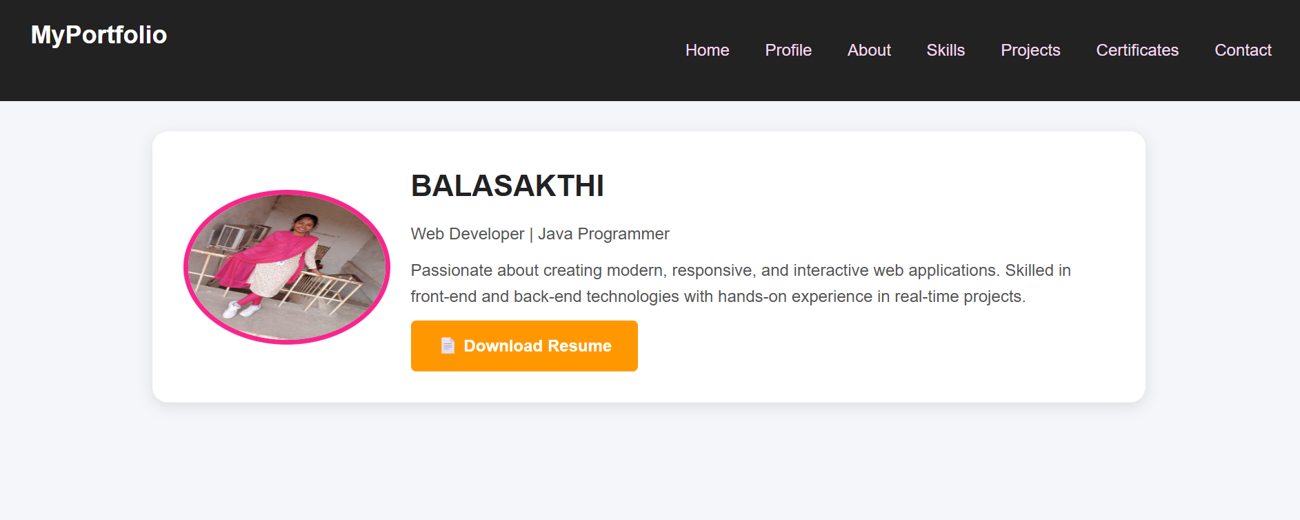

Slide 14
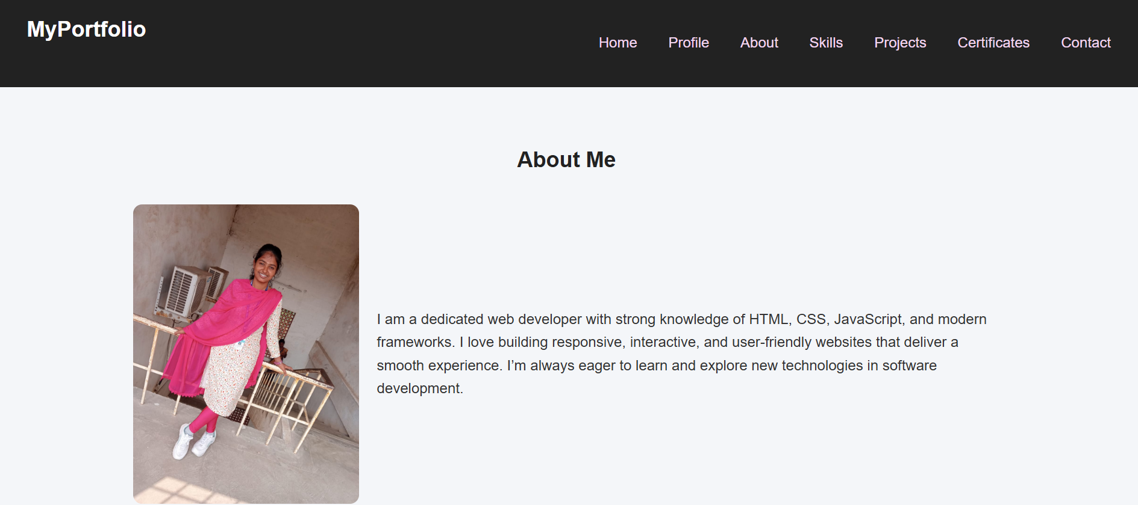

Slide 15
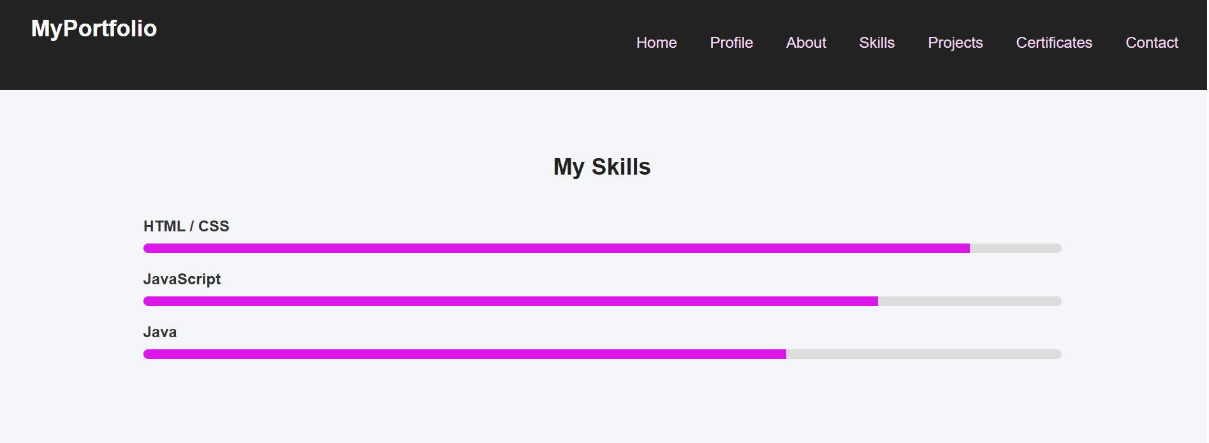

Slide 16
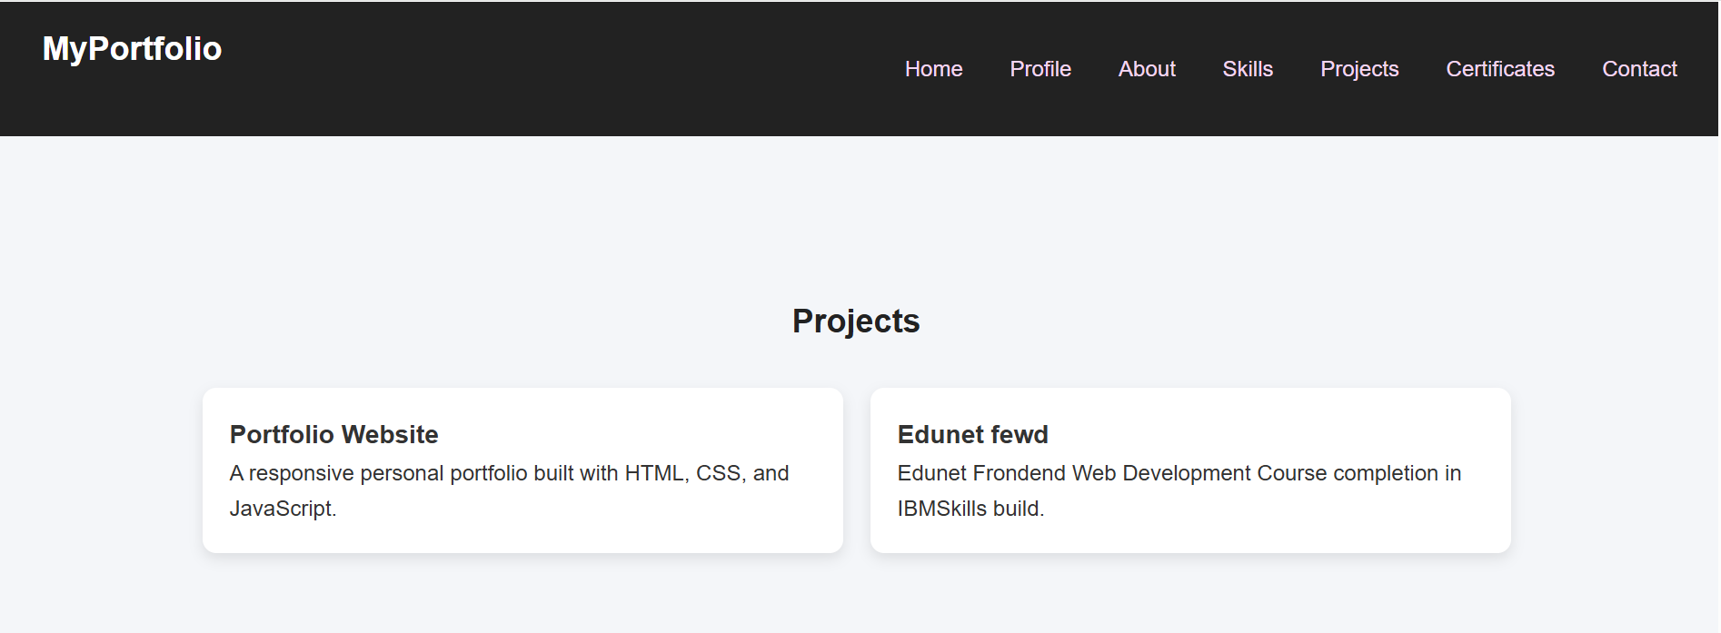

Slide 17
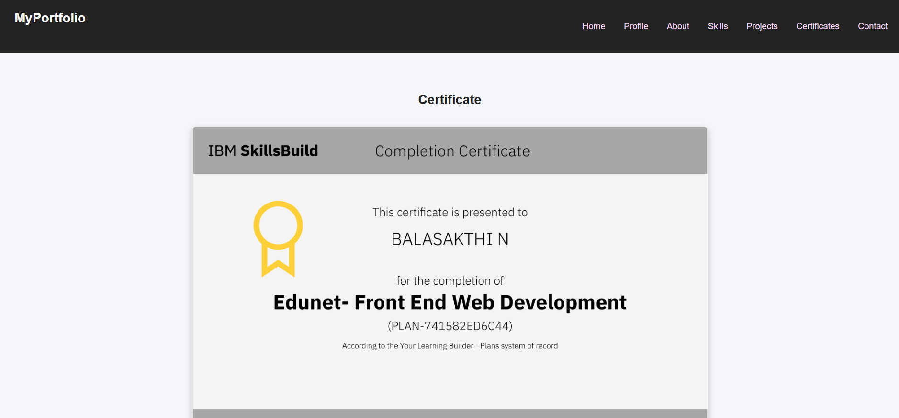

Slide 18
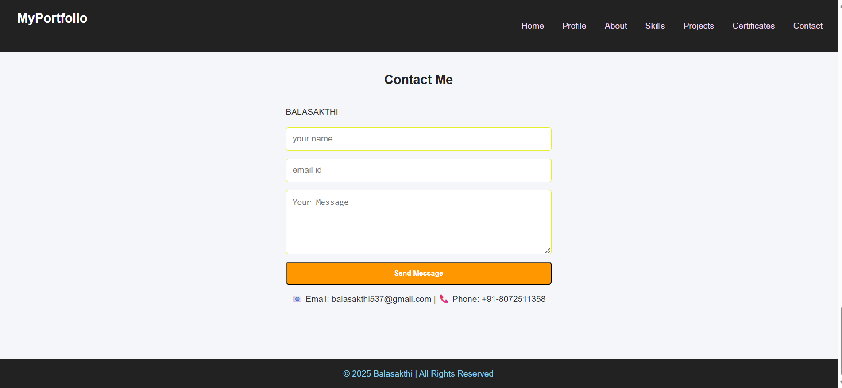

Slide 19
CONCLUSION
Portfolio acts as a digital resume
Display achievements and skills in one place
Enhances personal branding and job opportunities

Slide 20
GITHUB LINK
https://github.com/balasakthi537-star/TNSDC-FWD-DPT.git

